Slide 1
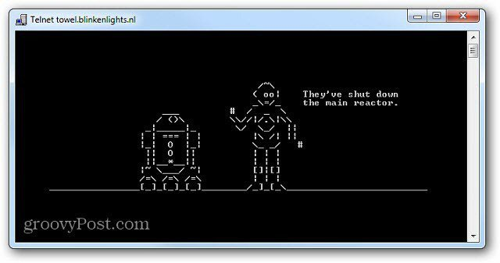
Strings & I/O
Working with string data-type and reading and writing to the console

Slide 2
Objectives
String data-type concatination and class member methods
Standard functions for converting strings to numbers and vice versa
Inputing and outputting text to and from the console
Working with numbers and the console
Reading multiple values from the console

Slide 3
Strings
Pseudo-primitive data type – std::string
Instaniate with value (delimiter – double quotes)
Concatenation “+” – append string literals together
Member methods:
size() or length() – return storage size of string variable in bytes (# of char)
+= or append() – add char or string to end of string variable
substr(pos, len) – get part of a string from pos for len characters or to end
std::string myStr = "Hello";
message = "Full name: " + firstName + " " + lastName;
myStr += otherStr.substr(3,4); // other 3-7

Slide 4
Functions: String <-> Numbers
Strings to numbers
std::stoi – convert string to integer
std::stoul – convert string to unsigned integer
std::stof – convert string to float
std::to_string – convert primitive number type to string
Numbers to String
int age = stoi(strAge);
string msgOut = "Letters printed " + to_string(letterCount);

Slide 5
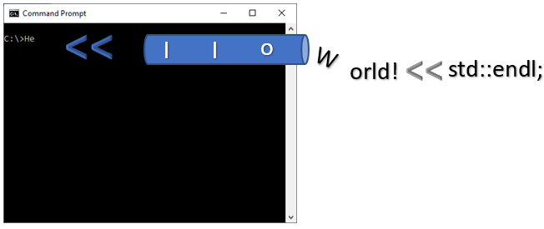
Output Text to Console
#include <iostream> - input/output stream library
Console Out “std::cout” – streams characters to standard-out
Insertion operator “<<” – add characters to output stream
std::cout << "Hello World!" << std::endl;

Slide 6
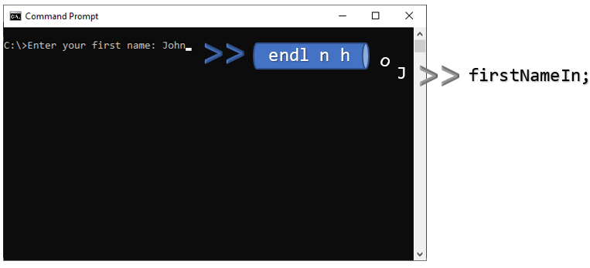
Input Text from Console
#include <iostream> - input/output stream library
Console In “std::cin” – reads characters from standard-in
extraction operator “>>” – extracts characters from input stream up-to first space or end-line character
Overloaded versions of extraction operator for each primitive type
std::cin >> firstNameIn;

Slide 7
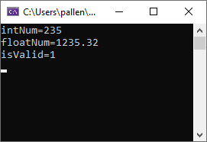
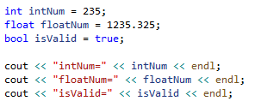
Outputting Numbers to Console

Slide 8
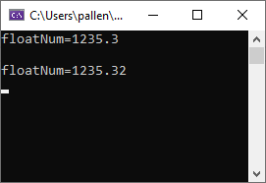
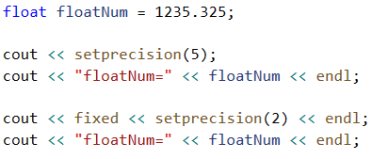
Formatting Float Numbers to Console
std::fixed and std::setprecision in the <iomanip> library

Slide 9
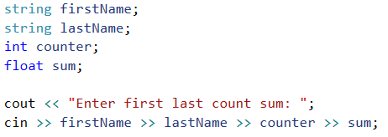

Read Multiple Values from Console

Slide 10
General I/O with Console
Prompt
Use std::cout with insertion operator "<<"
Message ending with colon and space "Enter name: "
Do not use std::endl so entry takes place on same line as prompt message
Read
use std::cin with extraction operator ">>"
Read one or more values terminated by space or enter
Read values into correct data-type (may cause errors if user provides bad data)
Display text
Use std::cout with insertion operator "<<" and std::endl
Use std::fixed and std::setprecision to format floating point numbers
Requires <iomanip>
Display numbers

